Slide 1

A MACHINE LEARNING-BASED NUMERICAL MODEL TO ASSESS FUTURE EXTREME HEAT SCENARIOS IN BANGLADESH AND ITS IMPACT ON PUBLIC HEALTH
A dissertation submitted to the Department of Department of Statistics and Data Science, Jahangirnagar University in partial fulfillment of the curriculum Masters in Applied Statistics and Data Science
Submitted by
Tanvir Ehsan
Roll: 20231063
Section: B
Batch: 10th
Submitted to
Farhana Akter Bina
Assistant Professor
Department of Statistics and Data Science
Jahangirnagar University,
Savar, Dhaka – 1342, Bangladesh
under
______________________________________
Date of Submission
June 2024

Slide 2
Topics to be covered:
Background of the study
Problem statement
Research questions
Research objectives
Rationale of the study
Research gaps
Methodology
Analysis and findings
Challenges
Conclusion
Limitations of the study and scope of the further research
References

Slide 3
Abstract and Keywords
Bangladesh is highly vulnerable to climate change, impacting public health.
This study forecasts future temperature scenarios using time series analysis.
Models used: ARIMA, ETS, and Double Exponential. Accurate forecasting aids in understanding and mitigating health impacts.
reviewing previous research reports
Mixed-method research methodology
Keywords: Climate, Forecast, Forecast Accuracy, Climate Change, Public Health, Bangladesh

Slide 4
Background of the study
Global Climate Change:
Climate change has increased the frequency, intensity, and duration of extreme heat events worldwide.
The Intergovernmental Panel on Climate Change (IPCC) reports significant global temperature rises over the past century, with further increase projected.
Bangladesh's Vulnerability:
Due to its tropical climate and high baseline temperatures, Bangladesh is particularly vulnerable to these changes.
Even small increase in mean temperatures can have significant health impacts, especially during summer months when temperatures often exceed human tolerance thresholds
Impact of Urbanization:
Rapid urbanization in Bangladesh exacerbates the impact of extreme heat.
Urban areas, with dense buildings, asphalt roads, and limited green spaces, experience higher temperatures than rural areas—known as the urban heat island effect.
Dhaka, one of the most densely populated cities globally, is particularly susceptible to this effect due to inadequate infrastructure and poor urban planning
Health Risks of Extreme Heat:
Extreme heat poses significant public health risks, including heat-related illnesses like heat exhaustion and heatstroke.
It also exacerbates pre-existing conditions such as cardiovascular and respiratory diseases.
Vulnerable populations, including the elderly, children, and those with chronic illnesses, are at higher risk.
In Bangladesh, public health infrastructure often struggles to manage the surge in heat-related illnesses during extreme heat events.

Slide 5
Problem statement
High Vulnerability: Bangladesh's tropical climate, dense population, and socio-economic conditions make it highly susceptible to climate change effects, particularly extreme heat.
Increasing Risks: Extreme heat events are expected to become more frequent and severe, posing significant public health risks.
Inadequate Models: Current predictive models lack the precision and granularity needed for effective planning and intervention.
Urgent Need: Robust predictive tools are urgently required to aid in proactive public health management.

Slide 6
Research questions:
The research work will find the answer to the following questions.
How can machine learning techniques be utilized to accurately predict future extreme heat events in Bangladesh?
What are the most significant climatic and non-climatic factors influencing the occurrence and severity of extreme heat events?
What is the projected impact of these extreme heat scenarios on public health, particularly heat-related illnesses?
How can the insights derived from the model inform public health strategies and policies to mitigate the impacts of extreme heat?

Slide 7
Research Objectives:
The purpose of this research proposal is
Develop an advanced machine learning-based numerical model
Predict future extreme heat scenarios in Bangladesh
Assess the potential impact of extreme heat on public health
Provide actionable insights for policymakers and public health officials
Mitigate adverse effects of extreme heat events on public health
The primary objectives of this study are as follows:
Analyze spatio-temporal variations in mean temperature in Bangladesh from 1971 to 2020.
Develop a machine learning-based model to forecast temperatures at up to 2040.
Correlate extreme heat events with heat-related diseases to predict future public health scenarios.
Formulate a best-fit equation to forecast heat-related disease incidence by 2040.

Slide 8
Rationale and Significance of the Study
The study on spatial-temporal variations of extreme heat and its connection to heat-related diseases in Bangladesh has profound implications:
Public Health Policy: It informs targeted interventions to safeguard vulnerable populations from heat-related health risks.
Urban Planning: It guides the development of climate-resilient urban areas through improved infrastructure and mitigation strategies for urban heat islands.
Global Contribution: The findings contribute to global public health initiatives by offering insights and strategies to mitigate the impacts of climate change on public health worldwide.
Overall, the study underscores the importance of integrating climate considerations into public health and urban planning efforts to enhance resilience and protect populations from the escalating threats of extreme heat.

Slide 9
Literature review:
There are several research works regarding all across the world, however, no significant research has been published regarding challenges and prospects in Bangladesh. Relevant works of literature have been reviewed by the researchers.
No formal study on increase of heat waves in Bangladesh has been undertaken but the increasing trend of temperature has been found in Bangladesh in several studies. Increased temperature may result different types of complicacy for human health.
Rahman (2008)5 reported that the health impacts associated with heat waves are heat stroke, dehydration and aggravation of cardiovascular diseases in elderly.
Climatic conditions impact the epidemiology of infectious diseases. Furthermore, these climatic factors interact with additional factors such as behavioral, demographic, and socioeconomic ones that influence the incidence, emergence, and distribution of such infectious diseases (Watts et al. 2018). Climate suitability for climate-sensitive infectious diseases has increased globally (Watts et al. 2020). Vectorial capacity is increasing for a number of climate-sensitive diseases,3 with exposures along a range of temperature and rainfall. These are most acutely experienced in low- and middle-income countries (Watts et al. 2019). The number of cases of dengue fever, which is spread by mosquitoes, recorded annually has doubled every decade since 1990, and one of the potential factors that contributed to this increase is climate change (Watts et al. 2020).(Mahmud & Raza, n.d.)

Slide 10
Research gap:
Comprehensive, as well as significant study, has been found hardly regarding this matter in Bangladesh.
The study addresses a crucial gap in research by focusing on Bangladesh's specific context regarding extreme heat and its impact on public health.
Research Focus: Investigating spatio-temporal variations in mean temperatures from 2000 to 2022 in Bangladesh.
Importance: Provides essential data to develop targeted interventions and adaptation strategies, crucial for mitigating adverse health effects of extreme heat in Bangladesh.
Practical Implications: Informs policymakers, urban planners, and healthcare professionals to implement effective measures tailored to local climate conditions and population vulnerabilities.

Slide 11
Methodology of the Study:
Research Approach and Types of Data
This study has been initiated by collecting primary data from Researchers and government and private employee from relevant sectors and associated organization reviewing previous research reports, newspaper articles, and online document reports from the various Organization of Bangladesh.
Mixed-method research methodology has been used which includes both quantitative and qualitative approaches.
Quantitative data shows the numerical presentation of data along with necessary tables & charts.
On the other hand, qualitative data has been illustrated through descriptive presentation.

Slide 12

Hypothesis of the Study
The study has been conducted on the basis of the following hypothesis.
Null Hypothesis (H0)
There is no significant relationship between extreme heat events and the incidence of heat-related illnesses in Bangladesh.
Alternative Hypothesis (H1)
There is a significant relationship between extreme heat events and the incidence of heat-related illnesses in Bangladesh.

Slide 13
Primary Data: Primary source information has been gathered from the farmers from the selected regions. Researchers, Private and govt. officers of relevant sectors and associated organizations have also been consulted for their expert opinion.
Secondary Data: Secondary data of the related issues have been collected from various books, policies, journal articles, newspaper articles and presentations. Relevant content will be analyzed to critically and objectively review published and printed facts, opinions and observations too.

Slide 14
Data Collection
Sampling is a statistical technique that involves selecting a limited number of elements from a larger population in order to make inferences about that population. Probability sampling operates on the principle of random selection, employing a carefully controlled process to ensure that every element in the population has a discernible, non-zero likelihood of being chosen. Random Sampling has been used for data collection. Both primary and secondary data have been used in this study and findings would have been developed on the basis of collected data. Primary cross-sectional data would have been collected in different sampling methods, including- direct/telephonic interview, emailing by using semi-structured questionnaire, FGDs. Qualitative data have been gathered by informal discussion/interview conducted on farmers, govt. officers, researchers, and so on.

Slide 15
Questionnaire Design
The questionnaire for the survey is comprised of two parts; the first part includes name, designation and organization about respondents’ age and profession. All the questions are multiple-choice and close-ended questions. Because of being closed- ended and multiple-choice in nature. The results of the questions are easy to compare, tabulate and analyze. In the questions 5-point Likert-scale was used where the respondents are asked to select the most appropriate number those correspondents to extent to which they agree with a statement. The scales in our survey questions are 1 to 5 with “1” denoting “strongly disagree” and “5” denoting “strongly agree”. A five-point Likert scale is used to determine the importance and acceptance of each question.

Slide 16
Processing and Analysis of Data
Data collected from primary as well as secondary sources will be analyzed to understand the present condition, Different figures, tables will be produced through various analytical tools, techniques. Furthermore, statistic software R, Minitab, Python software has been used to analyses the data.

Slide 17
Conceptual Framework

Slide 18
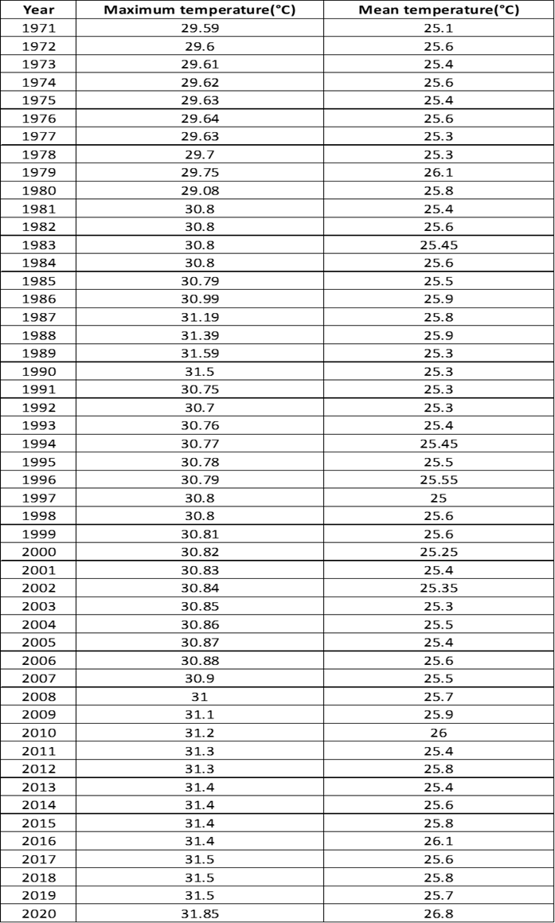
Maximum and Mean temperature of Bangladesh in the past years from 1971 to 2020 (Source (BMD)
From the above table it exhibits Maximum and Mean temperature of Bangladesh during the period from 1971 to 2020

Slide 19
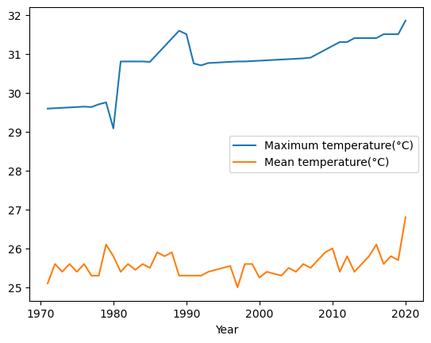
Data Analysis and Findings:
Figure 4.1:Variation in maximum and mean temperature (1971-2020) Source(BMD)
The above time series plot exhibits maximum and mean temperature from 1971 to 2020. In 2020, maximum temperature was 31.5 °C which was the highest temperature from 1971 to 2020. On the other hand, in 1971, maximum temperature was 29.59°C which was the lowest maximum temperature from 1971 to 2020. In the event of mean temperature, maximum mean temperature was 26.8 °C in 2020 which was the highest mean temperature from 1971 to 2020. However, in 1971, mean temperature was 25.1°C which was the lowest mean temperature from 1971 to 2020.

Slide 20
Data Analysis and Findings:
Figure 4.5:Trend Analysis plot for Mean temperature(°C)
The above trend analysis of time series plot shows fluctuation in temperature from the mean and exhibits a clear increasing trend in the temperature of Bangladesh from 1971 to 2019.

Slide 21
Data Analysis and Findings:
Figure 4.6:Forcasting Analysis plot for Mean temperature(°C)

Slide 22
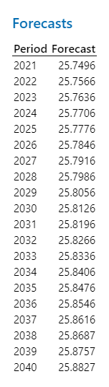
Table 2:Forecasts of Mean temperature
The temperature data shown above reveals that there is temperature will rise in the upcoming years.

Slide 23
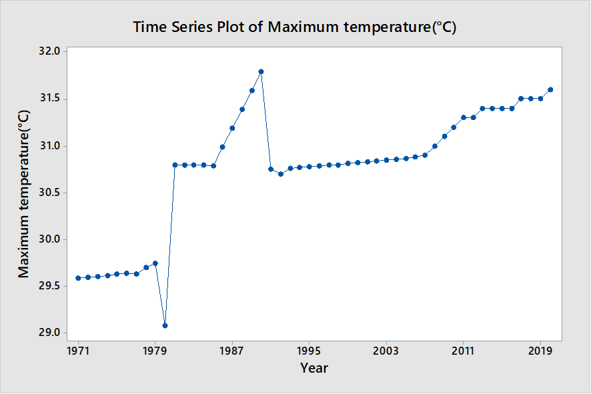
Time series plot for maximum temperature(°C)
The above time series plot exhibits maximum temperature from 1971 to 2020. In 2020, maximum temperature was 31.5 °C which was the highest temperature from 1971 to 2020. On the other hand, in 1971, maximum temperature was 29.59°C which was the lowest maximum temperature from 1971 to 2020

Slide 24
Figure 4.8:Trend Analysis plot for maximum temperature(°C)
The above time series analysis for maximum temperature from the past years indicate a clear upward trend in the temperature of Bangladesh.

Slide 25
Trend Analysis Plot for Maximum Temperature (°C)
Figure 4.9:Forcasting Analysis plot for Maximum temperature(°C)
The above time series analysis shows increasing trend of temperature in the upcoming years.

Slide 26
Table 3:Forecasts for Maximum temperature(°C)
Year | Forecasts for Maximum temperature(°C)
2021 | 31.6811
2022 | 31.7170
2023 | 31.7530
2024 | 31.7890
2025 | 31.8250
2026 | 31.8610
2027 | 31.8970
2028 | 31.9330
2029 | 31.9690
2030 | 32.0050
2031 | 32.0410
2032 | 32.0770
2033 | 32.1130
2034 | 32.1490
2035 | 32.1850
2036 | 32.2210
2037 | 32.2570
2038 | 32.2930
2039 | 32.3289
2040 | 32.3649
The above table shows increasing trend of temperature in the upcoming years.

Slide 27
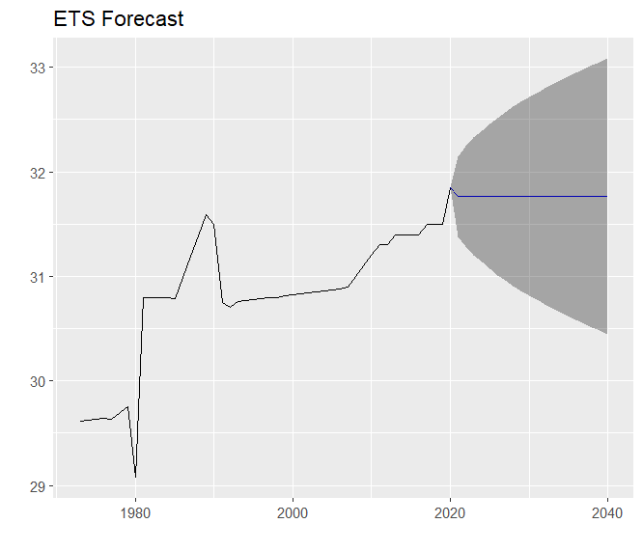
Figure 4.10:ETS forecasting Analysis plot for Maximum temperature(°C)
The above figure reveals that temperature will rise in the future.

Slide 28
Table 4:ETS forecasting for Maximum temperature(°C)
The above table shows increasing trend of temperature in the upcoming years

Slide 29
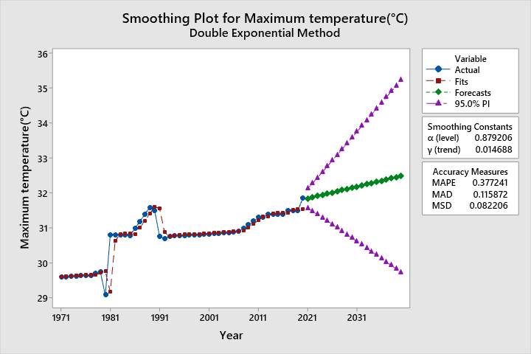
Forecasts for Maximum temperature(°C) Double Exponential Method
Figure 4.11:Forecasts for Maximum temperature(°C) Double Exponential Method

Slide 30
Table 5:Forecasts for Maximum temperature(°C) Double Exponential Method
Year | Forecast | Lower | Upper
2021 | 31.8455 | 31.5617 | 32.1294
2022 | 31.8793 | 31.4788 | 32.2799
2023 | 31.9131 | 31.3883 | 32.4378
2024 | 31.9468 | 31.2946 | 32.5991
2025 | 31.9806 | 31.1992 | 32.7620
2026 | 32.0144 | 31.1029 | 32.9258
2027 | 32.0481 | 31.0059 | 33.0903
2028 | 32.0819 | 30.9086 | 33.2552
2029 | 32.1156 | 30.8110 | 33.4203
2030 | 32.1494 | 30.7131 | 33.5857
2031 | 32.1832 | 30.6152 | 33.7511
2032 | 32.2169 | 30.5171 | 33.9168
2033 | 32.2507 | 30.4189 | 34.0824
2034 | 32.2844 | 30.3207 | 34.2482
2035 | 32.3182 | 30.2224 | 34.4141
2036 | 32.3520 | 30.1240 | 34.5799
2037 | 32.3857 | 30.0256 | 34.7459
2038 | 32.4195 | 29.9272 | 34.9118
2039 | 32.4533 | 29.8287 | 35.0778
2040 | 32.4870 | 29.7302 | 35.2438
The above time series analysis using double exponential method shows maximum temperature(°C) rise considerably in the future years.

Slide 31
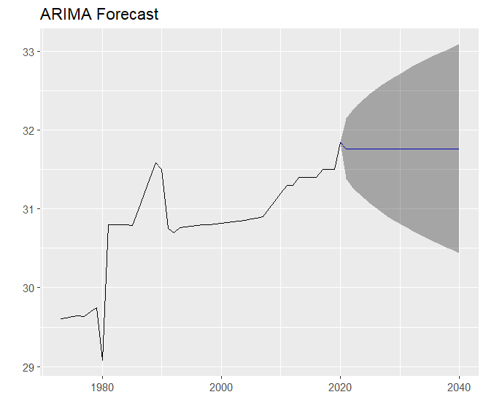
Figure 4.12:ARIMA Forecasting Analysis plot for Maximum temperature(°C)
From the above time series analysis using Arima method shows maximum temperature(°C) rise considerably in the future years.

Slide 32
Table 6:ARIMA Forecasting Analysis plot for Maximum temperature(°C) Source (DG Health, 2015-17)
Point Forecast Lo 80 Hi 80 Lo 95 Hi 95
2021 31.76587 31.38303 32.14872 31.18036 32.35138
2022 31.76587 31.28488 32.24687 31.03025 32.50149
2023 31.76587 31.20361 32.32814 30.90596 32.62578
2024 31.76587 31.13268 32.39906 30.79749 32.73425
2025 31.76587 31.06894 32.46281 30.70000 32.83174
2026 31.76587 31.01055 32.52119 30.61071 32.92103
2027 31.76587 30.95637 32.57537 30.52785 33.00390
2028 31.76587 30.90559 32.62615 30.45019 33.08155
2029 31.76587 30.85765 32.67409 30.37687 33.15488
2030 31.76587 30.81211 32.71963 30.30723 33.22452
2031 31.76587 30.76866 32.76309 30.24076 33.29098
2032 31.76587 30.72701 32.80473 30.17708 33.35467
2033 31.76587 30.68698 32.84477 30.11585 33.41590
2034 31.76587 30.64837 32.88337 30.05681 33.47494
2035 31.76587 30.61106 32.92068 29.99974 33.53200
2036 31.76587 30.57492 32.95683 29.94446 33.58728
2037 31.76587 30.53984 32.99191 29.89081 33.64093
2038 31.76587 30.50573 33.02601 29.83866 33.69309
2039 31.76587 30.47253 33.05921 29.78788 33.74387
2040 31.76587 30.44016 33.09159 29.73836 33.7933
From the table data using Arima method shows maximum temperature(°C) will rise considerably in the future years.

Slide 33
Table 7:Diarrhoea Cases in the Past
Year | Diarrhoea
2000 | 1556
2001 | 1866
2002 | 2599
2003 | 2287
2004 | 2246
2005 | 2152
2006 | 1962
2007 | 2335
2008 | 2295
2009 | 2619
2010 | 2427
2011 | 2268
2012 | 2631
2013 | 2641
The above table for diarrhoea cases show lowest number of diarrhea cases that was 1556 during 2000 to 2013. On the other hand, in 2013, it was rocketed which was 2641number of diarrhoea cases.

Slide 34
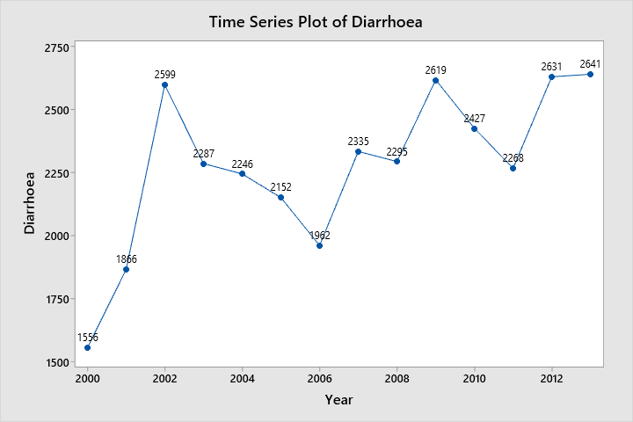
Figure 4.13:Time Series plot for Diarriah in the past
The above time series plot for cases show lowest number of diarrhoea cases that was 1556 during 2000 to 2013. On the other hand, in 2013, it was rocketed which was 2641number of diarrhoea cases.

Slide 35
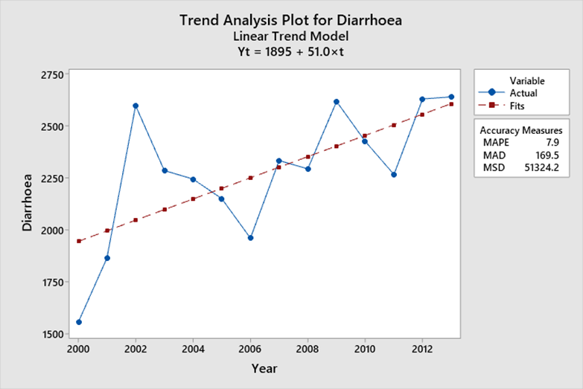
Figure 4.14:Trend Analysis plot for Diarriah in the past
The above time series plot for diarrhea cases show lowest number of diarrhea cases that was 1556 during 2000 to 2013. On the other hand, in 2013, it was rocketed which was 2641number of diarrhea cases. So, the above time series plot exhibits a clear upward trend regarding the diarrhea cases of Bangladesh during 2000 to 2013

Slide 36
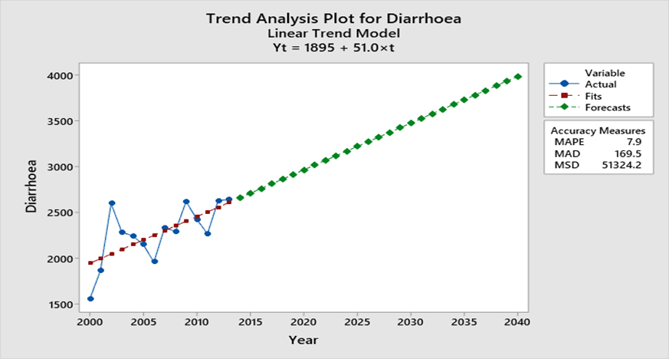
Figure 4.15:Forecasted Diarrhoea Cases
The above time series plot for diarrhoea cases show lowest number of diarrhea cases that was 1556 during 2000 to 2013. On the other hand, in 2013, it was rocketed which was 2641number of diarrhoea cases. So, the above time series plot exhibits a clear upward trend regarding the diarrhea cases of Bangladesh during 2000 to 2013.

Slide 37
Table9: Forecasted Diarriah Cases
Year | Forecasted Diarriah Cases
2014 | 2659.65
2015 | 2710.61
2016 | 2761.57
2017 | 2812.54
2018 | 2863.50
2019 | 2914.46
2020 | 2965.42
2021 | 3016.39
2022 | 3067.35
2023 | 3118.31
2024 | 3169.27
2025 | 3220.24
2026 | 3271.20
2027 | 3322.16
2028 | 3373.13
2029 | 3424.09
2030 | 3475.05
2031 | 3526.01
2032 | 3576.98
2033 | 3627.94
2034 | 3678.90
2035 | 3729.86
2036 | 3780.83
2037 | 3831.79
2038 | 3882.75
2039 | 3933.71
2040 | 3984.68
From the above table, it is anticipated that Diarriah cases will increase significantly in the future.

Slide 38
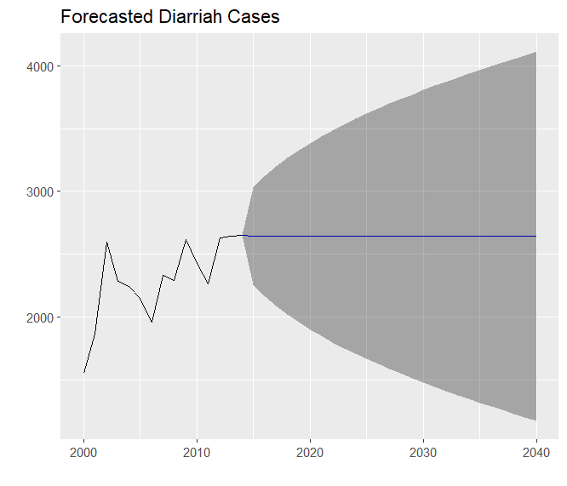
Forecasted DiarrhoeaCases ETS model
Figure 4.16:Forecasted Diarriah Cases ETS model
From the above figure, it is anticipated that Diarrhoea cases will increase significantly in the future.

Slide 39
From the above table, it is anticipated that diarrhoea cases will increase significantly in the future.
Table 10: Forecasted Diarrihoea Cases ETS model
Point Forecast Lo 80 Hi 80 Lo 95 Hi 95
2015 2642.98 2256.112 3029.847 2051.3167 3234.642
2016 2642.98 2163.710 3122.249 1909.9998 3375.959
2017 2642.98 2086.443 3199.516 1791.8311 3494.128
2018 2642.98 2018.668 3267.291 1688.1769 3597.782
2019 2642.98 1957.561 3328.398 1594.7227 3691.236
2020 2642.98 1901.473 3384.486 1508.9439 3777.015
2021 2642.98 1849.340 3436.619 1429.2122 3856.747
2022 2642.98 1800.426 3485.533 1354.4045 3931.555
2023 2642.98 1754.199 3531.760 1283.7077 4002.251
2024 2642.98 1710.261 3575.698 1216.5103 4069.449
2025 2642.98 1668.302 3617.657 1152.3391 4133.620
2026 2642.98 1628.076 3657.883 1090.8187 4195.140
2027 2642.98 1589.385 3696.574 1031.6454 4254.314
2028 2642.98 1552.065 3733.894 974.5695 4311.389
2029 2642.98 1515.980 3769.979 919.3826 4366.576
2030 2642.98 1481.015 3804.944 865.9087 4420.050
2031 2642.98 1447.072 3838.887 813.9975 4471.961
2032 2642.98 1414.067 3871.892 763.5196 4522.439
2033 2642.98 1381.925 3904.034 714.3624 4571.597
2034 2642.98 1350.582 3935.377 666.4274 4619.532
2035 2642.98 1319.981 3965.978 619.6277 4666.331
2036 2642.98 1290.072 3995.887 573.8862 4712.073
2037 2642.98 1260.810 4025.149 529.1343 4756.825
2038 2642.98 1232.156 4053.803 485.3104 4800.649
2039 2642.98 1204.071 4081.888 442.3591 4843.600
2040 2642.98 1176.525 4109.434 400.2302 4885.729

Slide 40
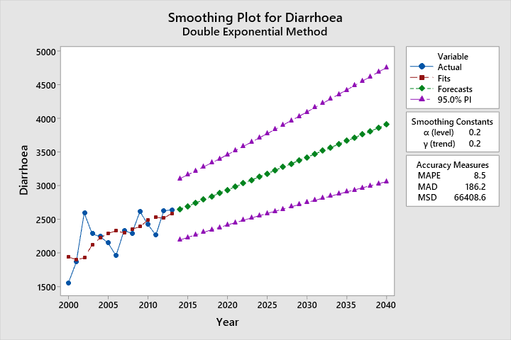
Figure 4.17:Forecasted Diarriah Cases Double Exponential model
From the above time series Double Exponential model, it is anticipated that diarrhoea cases will increase significantly in the future.

Slide 41
Table 11: Forecasted Diarrhoea Cases Double Exponential model
Year | Forecasted Diarrhoea Cases Double Exponential model | Lower | Upper
2014 | 2623.45 | 2192.20 | 3054.70
2015 | 2668.74 | 2221.68 | 3115.80
2016 | 2714.04 | 2249.73 | 3178.34
2017 | 2759.33 | 2276.49 | 3242.16
2018 | 2804.62 | 2302.11 | 3307.13
2019 | 2849.91 | 2326.72 | 3373.11
2020 | 2895.21 | 2350.43 | 3439.98
2021 | 2940.50 | 2373.34 | 3507.65
2022 | 2985.79 | 2395.55 | 3576.03
2023 | 3031.08 | 2417.14 | 3645.03
2024 | 3076.37 | 2438.17 | 3714.58
2025 | 3121.67 | 2458.70 | 3784.63
2026 | 3166.96 | 2478.79 | 3855.13
2027 | 3212.25 | 2498.49 | 3926.01
2028 | 3257.54 | 2517.83 | 3997.25
2029 | 3302.84 | 2536.86 | 4068.81
2030 | 3348.13 | 2555.60 | 4140.65
2031 | 3393.42 | 2574.08 | 4212.76
2032 | 3438.71 | 2592.33 | 4285.09
2033 | 3484.00 | 2610.37 | 4357.64
2034 | 3529.30 | 2628.21 | 4430.38
2035 | 3574.59 | 2645.88 | 4503.30
2036 | 3619.88 | 2663.39 | 4576.37
2037 | 3665.17 | 2680.75 | 4649.60
2038 | 3710.47 | 2697.97 | 4722.96
2039 | 3755.76 | 2715.08 | 4796.44
2040 | 3801.05 | 2732.06 | 4870.03
From the above time series Double Exponential model, it is anticipated that diarrhoea cases will increase significantly in the future.

Slide 42
Table12: Dengue cases of Bangladesh in the past Source (DG Health, 2015-17)
From the above table it exhibits Dengue cases of Bangladesh during the period from 2000 to 2019

Slide 43
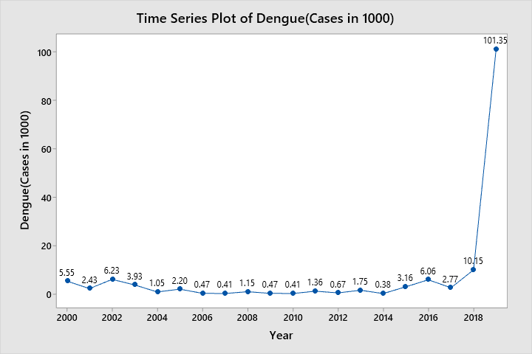
Time Series plot for Dengue Cases in the past
Figure 4.18:Time Series plot for Dengue Cases in the past
The above time series plot shows a clear upward trend regarding the Dengue (Cases in 1000) of Bangladesh during 2000 to 2018

Slide 44
Figure 4.19:Trend Analyses Plot for Dengue cases of Bangladesh in the past
The above time series plot shows a clear upward trend regarding the Dengue (Cases in 1000) of Bangladesh during 2000 to 2019.

Slide 45
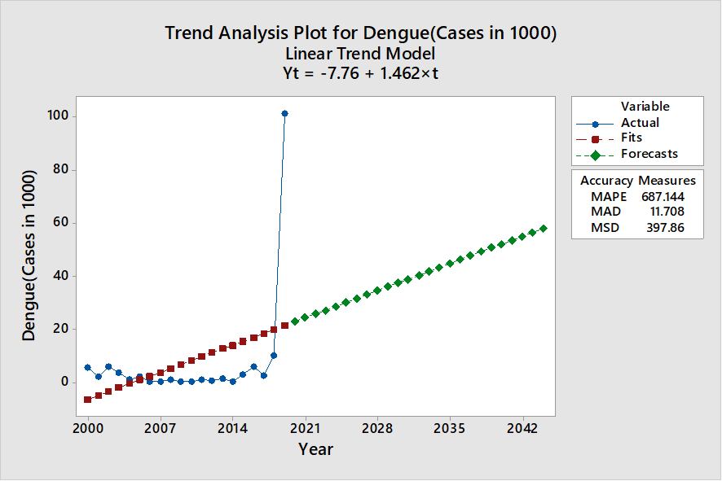
Forecasting dengue Cases
Figure 4.20:Forecasted Dengue Cases

Slide 46
Forecasted Dengue Cases
Table 13: Forecasted Dengue Cases
Year Forecasted Dengue Cases
2020 22.9519
2021 24.4142
2022 25.8765
2023 27.3389
2024 28.8012
2025 30.2635
2026 31.7258
2027 33.1882
2028 34.6505
2029 36.1128
2030 37.5751
2031 39.0375
2032 40.4998
2033 41.9621
2034 43.4244
2035 44.8867
2036 46.3491
2037 47.8114
2038 49.2737
2039 50.7360
2040 52.1984
From the above time series plot, it is expected that Dengue Cases will rise considerably in the future.

Slide 47
From the above table it exhibits Heat index in Dhaka during the period from 2000 to 2018

Slide 48
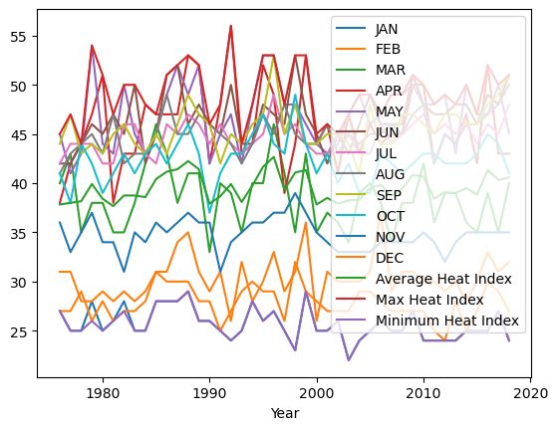
Figure 4.21:Time series Analyses of Heat index in Dhaka in the past
The above timeseries graph shows the Heat index during the period from the year 1976 to 2018. In the year 1992 Maximum Heat index was 54. On the other hand, In the year 1993 it was lowest which was 44. In the event Of Average Heat index, it was around 43in the year 1996 which was highest.

Slide 49
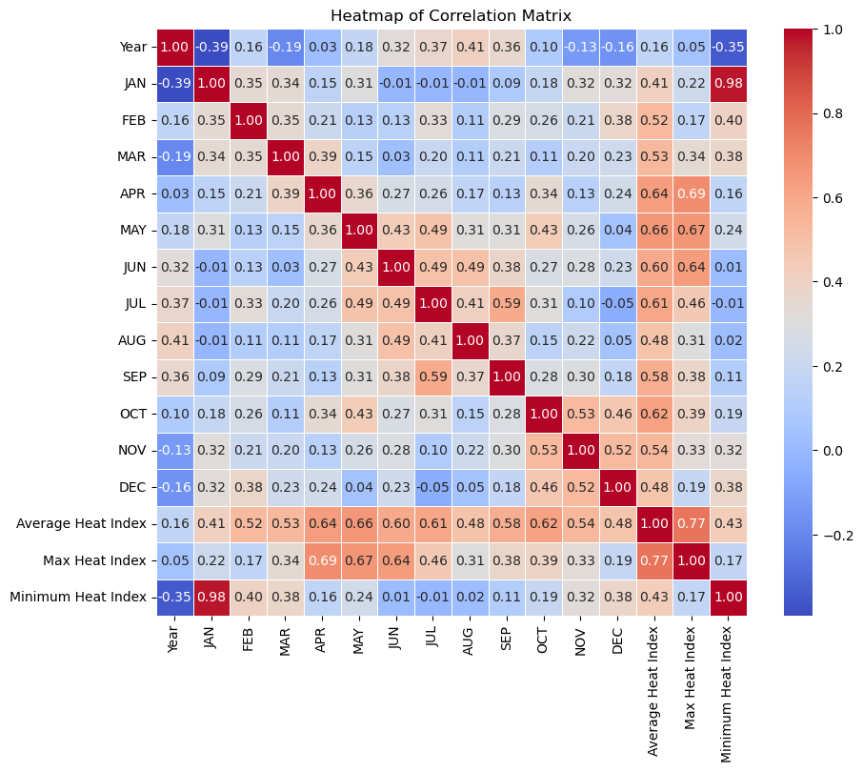
Figure 4.22:Heatmap of Correlation Matrix of Heat Index
Correlation plot heatmap representing the correlation between sixteen pairs of variables during the period. Furthermore, the color indicating the strength and direction of the correlations. Darker shades indicate stronger correlations. Dark blue colors indicate variables that tend to vary in opposite directions.

Slide 50
Impact of temperature on Diarrhoea in Bangladesh
Table15: Maximum temperature VS Diarrhoea cases in Bangladesh
The above table shows that there is a Maximum temperature VS Diarrhoea cases in Bangladesh experienced a significant increase.

Slide 51
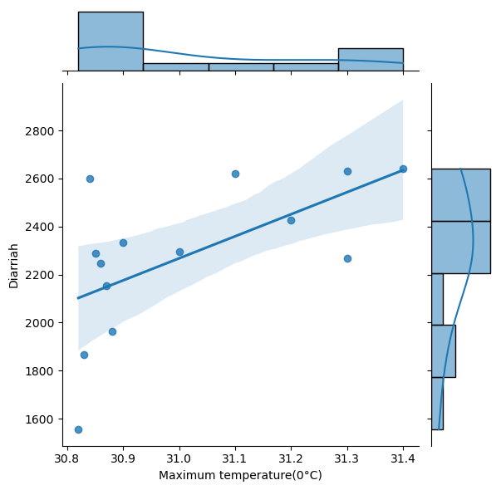
Figure 4.24: Joint plot showing the relationship between maximum temperature (in °C) and cases of Diarrhoea
Here is the joint plot showing the relationship between maximum temperature (in °C) and cases of of Diarrhoea. The scatter plot in the center visualizes this relationship, while the histograms along the margins display the distributions of each variable individually. From the plot, it appears that as the temperature increases, the number of of Diarrhoea cases increases, suggesting a potential positive relationship between these variables. ​This is evident from the upward slope in the scatter plot, indicating a positive correlation between these two variables. Overall, the joint plot provides a clear visual representation of the positive correlation between maximum temperature and of Diarrhoea cases, highlighting a potential area for further investigation.Inthe joint point we find evidence Of Outlier.

Slide 52
Figure 4.25:Regression analysis for of Diarrhoea vs Maximum temperature
From figure 4.29, Pearson correlation coefficient of 0.599 indicates a moderately positive linear relationship between two variables. The correlation coefficient (r) ranges from -1 to
A value of 0.599 suggests that there is a moderate positive correlation between the two variables. This means that as one variable increases, the other tends to increase as well, though not perfectly. The positive sign indicates that as one variable increases, the other also tends to increase. In contrast, a negative correlation coefficient would indicate that as one variable increases, the other tends to decrease. While 0.599 is not a perfect correlation (which would be 1 or -1), it still indicates a noticeable tendency for the variables to move together. This can be useful in understanding how changes in one variable might predict changes in the other, though it does not imply causation.To determine if this correlation is statistically significant (i.e., not likely due to random chance), one would typically look at the p-value associated with the correlation coefficient. If the p-value is sufficiently low (often less than 0.05), the correlation is considered statistically significant.To recapitulate, a Pearson correlation coefficient of 0.599 indicates a moderate positive linear relationship between two variables, suggesting that they tend to move together in a positive direction, but not perfectly so.

Slide 53
Impact of temperature on Dengue in Bangladesh Table 16: Maximum temperature VS Dengue cases in Bangladesh
Year | Maximum temperature(°C) | Dengue (Cases in 1000)
2000 | 30.82 | 5.55
2001 | 30.83 | 2.43
2002 | 30.84 | 6.23
2003 | 30.85 | 3.93
2004 | 30.86 | 1.05
2005 | 30.87 | 2.2
2006 | 30.88 | 0.47
2007 | 30.9 | 0.41
2008 | 31 | 1.15
2009 | 31.1 | 0.47
2010 | 31.2 | 0.41
2011 | 31.3 | 1.36
2012 | 31.3 | 0.67
2013 | 31.4 | 1.75
2014 | 31.4 | 0.38
2015 | 31.4 | 3.16
2016 | 31.4 | 6.06
2017 | 31.5 | 2.77
2018 | 31.5 | 10.15
2019 | 31.5 | 101.35
Pearson correlation coefficient: 0.33

Slide 54
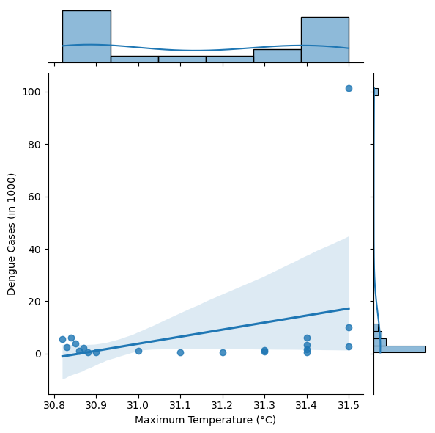
Figure 4.26: joint plot showing the relationship between maximum temperature (in °C) and cases of Dengue Cases(in1000)
Here is the joint plot showing the relationship between maximum temperature (in °C) and cases of Dengue Cases (in1000). The scatter plot in the center visualizes this relationship, while the histograms along the margins display the distributions of each variable individually.
The joint plot displays the relationship between maximum temperature (in °C) and cases of diarrhea. As the maximum temperature increases, the number Dengue cases increases. This is evident from the upward slope in the scatter plot, indicating a positive correlation between these two variables. The joint plot displays the relationship between maximum temperature (in °C) and cases of diarrhea. As the maximum temperature increases, the number Dengue cases increases. This is evident from the upward slope in the scatter plot, indicating a positive correlation between these two variables.

Slide 55
Figure 4.31 Regression analyses for Dengue (Cases in 1000) vs Maximum temperature(°C)
In figure 4.31, Pearson correlation coefficient of 0.33 indicates a moderate positive linear relationship between Dengue cases and Maximum Temperature. The positive sign indicates that as one variable increases, the other variable tends to increase as well. A correlation of 0.33 suggests a weak to moderate strength of association. This means that there is a noticeable relationship, however it's not very strong. In practical terms, this could imply that about 11% (0.33^2) of the variability in one variable can be explained by the variability in the other variable. The remaining 89% is influenced by other factors or random variation.

Slide 56
Conclusion
The findings of this study underscore the urgent need for proactive measures to mitigate and adapt to the increasing threat of extreme heat in Bangladesh. Utilizing a machine learning-based model, this research provides precise predictions that can guide public health interventions and policymaking, ultimately helping to protect vulnerable populations and enhance community resilience in the face of climate change.
This study demonstrates the efficacy of machine learning models in predicting extreme heat scenarios and their health impacts. The insights gained can guide public health policies and climate adaptation strategies in Bangladesh, ultimately reducing the adverse effects of climate change on human health.
This study demonstrates the efficacy of machine learning models in predicting extreme heat scenarios and their health impacts. The insights gained can guide public health policies and climate adaptation strategies in Bangladesh, ultimately reducing the adverse effects of climate change on human health.

Slide 57
Findings of this study
Considerable changes to the climate have already occurred in Bangladesh. Over the past 44 years, Bangladesh has become hotter, with a more than 1°C increase in mean temperature recorded between 1976 and 2019. Trend analyses indicate that the maximum temperature continues to rise for all months except December and has already substantially increased from February to November. Overall, summers are becoming hotter and longer with the monsoon period being extended from February and October, while winters are becoming warmer. Bangladesh appears to be losing its distinct seasonality.
The projected changes in climate will have considerable ramifications on the health of the population. With further climatic changes predicted across Bangladesh, including increase of temperature by approximately 1.4°C in the year 2040 causes deleterious effects on human physical as well as mental health that are likely to escalate.
Heat impacts on certain groups such as construction workers, transport drivers, farmers, fishermen and so on disproportionately. In addition, heat impacts on women as well as children in all ages. Therefore, heat impacts affect livelihood of the general people reducing income significantly, and causes personal health risks.
The recurrent heat events and associated impacts every year in these regions in the past few years have enabled heatwaves to be recognized as a serious concern in most countries. At the same time, cross-sectoral as well as comprehensive collaborative strategies that focus on providing immediate relief during the hot days are needed to eradicate this huge problem.
Implications for Public Health
Increased Healthcare Demand: The projected rise in heat-related illnesses will likely lead to increased demand for healthcare services, straining existing infrastructure. Emergency Preparedness: Improved emergency response plans will be necessary to handle the surge in heat-related health issues during extreme heat events.

Slide 58
Challenges
Data Availability and Quality: Reliable and comprehensive climate and health data are often difficult to obtain, which can hinder accurate modeling and analysis.
Integration of Diverse Datasets: Combining different types of data, such as climate, health, and socio-economic data, poses significant challenges due to differences in formats, scales, and collection methods.
Limited Focus on Indirect Effects: The study primarily focused on direct health impacts of heat, potentially overlooking important indirect effects such as economic and social consequences.
Resource Constraints: Implementing the recommended mitigation and adaptation strategies requires substantial financial and human resources, which may be limited.
Public Awareness and Engagement: Raising public awareness and changing behavior regarding heat risks and protective measures can be challenging, especially in rural and underserved communities.
Infrastructure Limitations: Existing healthcare and emergency response infrastructure may be inadequate to handle the projected increase in heat-related health issues.
Policy and Governance: Developing and enforcing effective policies for heat mitigation and adaptation requires strong governance and coordination among various stakeholders.

Slide 59
Recommendations
Urban Greening: Implementing green roofs, parks, and trees in urban areas to reduce the urban heat island effect.
Building Designs: Encouraging the use of heat-resistant building materials and designs that enhance ventilation and cooling.
5.3.1.2 Adaptation Measures:
Public Awareness Campaigns: Educating the public about heat risks and protective measures.
Early Warning Systems: Developing and implementing early warning systems to alert communities regarding impending heat waves. Record more accurate weather data with localized information. The Bangladesh Meteorological Department (BMD) needs to expand the number of weather stations geographically to be able to collect more localized and granular information on the various weather variables.
Healthcare System Strengthening: Investing in healthcare infrastructure and training to improve capacity and response to heat-related health issues.
Individual and community measures to cope with extreme heat: Using fans, staying indoors during peak heat, increasing hydration, and using shaded areas. Some communities may use traditional cooling methods such as cool baths and wet clothing.
Local policies or programs in place to help communities adapt to extreme heat: The government and NGOs often run awareness campaigns, establish cooling centers, and distribute water during severe heatwaves. There are also efforts to ameliorate urban planning to include more green spaces and better ventilation in crowded areas.

Slide 60
Limitations of the Study and Scope of the Further Research:
Dedicated Research Semester: Allocate a dedicated semester specifically for research to allow for more in-depth analysis and comprehensive understanding of the subject matter.
Reliable Secondary Data: Enhance efforts to obtain reliable and high-quality secondary data. This may involve establishing partnerships with data providers, using advanced data collection methods, or employing robust data validation techniques.
Integration of Diverse Datasets: Develop and implement advanced methodologies for the integration of diverse datasets. This could include using sophisticated statistical methods, machine learning algorithms, or data fusion techniques to minimize biases and improve the robustness of the models.
Generalization and Validation: Conduct extensive validation studies to test the generalizability of the models across different regions and conditions. This may involve using cross-validation techniques, out-of-sample testing, or applying the models to new datasets to ensure they perform well in various contexts.
Indirect Health Impacts: Broaden the scope of the study to include indirect heat-related health impacts. This requires a more comprehensive approach to data collection and analysis, considering factors such as social determinants of health, environmental conditions, and economic variables.
Correlation with Various Health Outcomes: Evaluate correlations with a wider range of health outcomes, including those related to malnutrition and disease prevalence. This involves conducting multi-variable analyses and exploring potential causal pathways to better understand the interconnectedness of health factors.
Interdisciplinary Approach: Foster collaboration among different disciplines, including epidemiology, environmental science, data science, and public health, to enrich the study with diverse perspectives and expertise.
Longitudinal Studies: Implement longitudinal studies to monitor changes over time and understand the long-term impacts of heat-related health issues. This can provide deeper insights into trends and causal relationships.
By addressing these areas, future research can achieve a more accurate, comprehensive, and generalizable understanding of heat-related health impacts and their broader implications.

Slide 61
REFERENCES
Rahman, A., & Islam, R. (2017). Urban heat island effect: A review on causes and effects. Earth and Environmental Science, 1(1), 13-21. DOI: 10.11648/j.earth.20170101.13
IPCC. (2018). Global warming of 1.5°C. An IPCC Special Report on the impacts of global warming of 1.5°C above pre-industrial levels and related global greenhouse gas emission pathways, in the context of strengthening the global response to the threat of climate change, sustainable development, and efforts to eradicate poverty. Retrieved from https://www.ipcc.ch/sr15/
Shahid, S. (2010). Recent trends in the climate of Bangladesh. Climate Research, 42(3), 185-193. DOI: 10.3354/cr00889
Murari, K. K., Ghosh, S., Patwardhan, A., Daly, E., & Salvi, K. (2015). Intensification of future severe heat waves in India and their effect on heat stress and mortality. Regional Environmental Change, 15(4), 569-579. DOI: 10.1007/s10113-014-0660-6

Slide 62
Sun, Y., Zhang, X., Zwiers, F. W., Song, L., Wan, H., Hu, T., & Yin, H. (2019). Rapid increase in the risk of extreme summer heat in Eastern China. Nature Climate Change, 9(1), 65-69. DOI: 10.1038/s41558-018-0258-2
Tan, J., Zheng, Y., Song, G., Kalkstein, L. S., Kalkstein, A. J., & Tang, X. (2010). Heat wave impacts on mortality in Shanghai, 1998 and 2003. International Journal of Biometeorology, 54(1), 83-89. DOI: 10.1007/s00484-009-0256-7
Lelieveld, J., Proestos, Y., Hadjinicolaou, P., Tanarhte, M., Tyrlis, E., & Zittis, G. (2016). Strongly increasing heat extremes in the Middle East and North Africa (MENA) in the 21st century. Climatic Change, 137(1-2), 245-260. DOI: 10.1007/s10584-016-1665-6
Alghamdi, A. S., & Moore, T. L. (2020). Urban heat island effect: A case study in the city of Riyadh, Saudi Arabia. Journal of Sustainable Development, 13(1), 187-195. DOI: 10.5539/jsd. v13n1p187
Robine, J. M., Cheung, S. L. K., Le Roy, S., Van Oyen, H., Griffiths, C., Michel, J. P., & Herrmann, F. R. (2008). Death toll exceeded 70,000 in Europe during the summer of 2003. Comptes Rendus Biologies, 331(2), 171-178. DOI: 10.1016/j.crvi.2007.12.001
Vautard, R., van Oldenborgh, G. J., Thao, S., Dubuisson, B., Lenderink, G., Ribes, A., ... & Soubeyroux, J. M. (2020). Human contribution to the record-breaking July 2019 heatwave in Western Europe. Environmental Research Letters, 15(9), 094077. DOI: 10.1088/1748-9326/aba3d4
López-Bueno, J. A., López-Bueno, M., & López-Bueno, C. (2021). Heat waves and mortality in Southern Europe: Analyzing the role of climate change. International Journal of Environmental Research and Public Health, 18(4), 1809. DOI: 10.3390/ijerph18041809
Sheridan, S. C., Kalkstein, L. S., & Scott, J. M. (2012). Variability in heat-related mortality in the United States, 1975-2004. Environmental Research, 112, 20-28. DOI: 10.1016/j.envres.2011.10.002

Slide 63
Cheng, C. S., Auld, H., Li, G., Li, Q., & Day, N. (2014). A synoptic weather typing approach to assess climatic impact on air quality and public health, and adaptation strategies in southern Canada. International Journal of Climatology, 34(10), 3196-3209. DOI: 10.1002/joc.3898
IPCC. (2018). Global warming of 1.5°C. An IPCC Special Report on the impacts of global warming of 1.5°C above pre-industrial levels and related global greenhouse gas emission pathways, in the context of strengthening the global response to the threat of climate change, sustainable development, and efforts to eradicate poverty. Retrieved from https://www.ipcc.ch/sr15/
Mora, C., Dousset, B., Caldwell, I. R., Powell, F. E., Geronimo, R. C., Bielecki, C. R., ... & Trauernicht, C. (2017). Global risk of deadly heat. Nature Climate Change, 7(7), 501-506. DOI: 10.1038/nclimate3322
Oke, T. R. (1982). The energetic basis of the urban heat island. Quarterly Journal of the Royal Meteorological Society, 108(455), 1-24. DOI: 10.1002/qj.49710845502
Ahmed, B., & Hasan, R. (2014). Urban heat island in Dhaka city: A remote sensing perspective. Journal of Bangladesh Institute of Planners, 7, 38-49.
Santamouris, M. (2015). Analyzing the heat island magnitude and characteristics in one hundred Asian and Australian cities and regions. Science of the Total Environment, 512, 582-598. DOI: 10.1016/j.scitotenv.2015.01.060
Vautard, R., van Oldenborgh, G. J., Thao, S., Dubuisson, B., Lenderink, G., Ribes, A., ... & Soubeyroux, J. M. (2020). Human contribution to the record-breaking July 2019 heatwave in Western Europe. Environmental Research Letters, 15(9), 094077. DOI: 10.1088/1748-9326/aba3d4
Sheridan, S. C., Kalkstein, L. S., & Scott, J. M. (2012). Variability in heat-related mortality in the United States, 1975-2004. Environmental Research, 112, 20-28. DOI: 10.1016/j.envres.2011.10.002

Slide 64
Sheridan, S. C., Kalkstein, L. S., & Scott, J. M. (2012). Variability in heat-related mortality in the United States, 1975-2004. Environmental Research, 112, 20-28. DOI: 10.1016/j.envres.2011.10.002
Honda, Y., Kondo, M., McGregor, G., Kim, H., Guo, Y. L., Hijioka, Y., & Yoshikawa, M. (2014). Heat-related mortality risk model for climate change impact projection. Environmental Health and Preventive Medicine, 19(1), 56-63. DOI: 10.1007/s12199-013-0354-6
IPCC. (2018). Global warming of 1.5°C. An IPCC Special Report on the impacts of global warming of 1.5°C above pre-industrial levels and related global greenhouse gas emission pathways, in the context of strengthening the global response to the threat of climate change, sustainable development, and efforts to eradicate poverty. Retrieved from https://www.ipcc.ch/sr15/
Hossain, M. S., & Majumder, R. K. (2019). Urban heat island and its effect on micro-climate changes in Dhaka city. Journal of Urban Management, 8(2), 176-189. DOI: 10.1016/j.jum.2019.03.002
Watts, N., et al. (2015). Health and climate change: policy responses to protect public health. The Lancet, 386(10006), 1861-1914. DOI: 10.1016/S0140-6736(15)60854-6

